Slide 1
CTS 6319 Cyber Security: Measurement and Data Analysis
Dr. Elias Bou-Harb
ebouharb@fau.edu EE 503B
Office hours: Mondays 4-6pm

Slide 2
Material
On Canvas
Research Papers 5 & 6:
Survey and taxonomy of botnet research through life-cycle
Your botnet is my botnet: analysis of a botnet takeover

Slide 3
Bots
A bot is an automated and an interactive program (code) to perform a redundant task
Benign bots: IRC Bot
Malicious bots: robots/zombies that are intended to execute malevolent tasks
Networks of bots form the notion of botnets

Slide 4
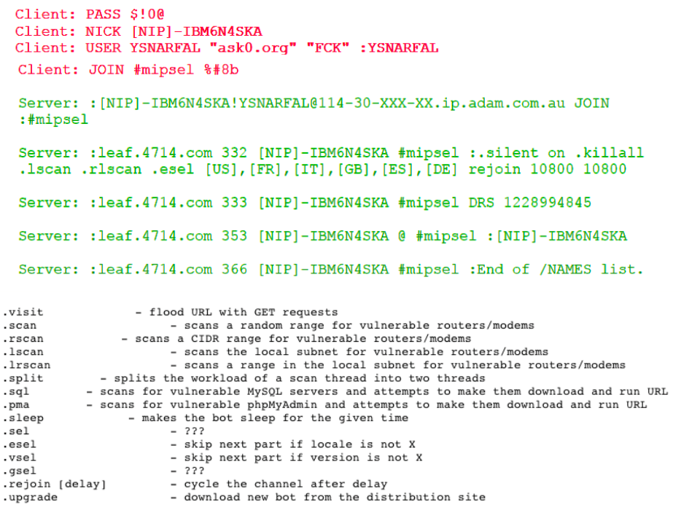
Bots

Slide 5
Botnet
A set of bots with the following features:
Highly coordinated by a botnet herder/botmaster
Highly orchestrated by the botmaster
Coordination refers to the infection and control processes
Orchestration refers to the (next step) attack process

Slide 6
Some famous botnets
Mariposa
ID theft, SSN, credit cards. 13M infections in >200 countries
Conflicker
ID theft, DDoS attack. 15M infection in 190 countries
Storm
Spamming, bank fraud. 50M infections. P2P botnet
Cutwail
Spamming. 1M spam email per minute. 2M infections
Windigo
Spamming. 35M spam email a day. Infected 10K linux servers.

Slide 7
Typical botnet applications
Spamming
Probing/DDoS
Click fraud
Keylogging/ID Thefts
Bitcoin Mining

Slide 8
Botnet Initiation
There must be an infection!
Propagating worm exploiting a vulnerability
Malicious email attachment
Social engineering
P2P site downloads
Drive by downloads
Backdoors
Any malware would typically do the task (Virus, worm, backdoor, Trojan, etc.)

Slide 9
Botnet Coordination/Orchestration
Malicious bots communicate with a botmaster using command and control channels
Botmaster commands:
How/where to propagate
New configuration files
Bot software updates
Attack types & methods, and victims

Slide 10
Botnet Coordination/Orchestration
Malicious bots will execute intended tasks
Return any data, if available (stolen data)
Return Acks for botmaster

Slide 11
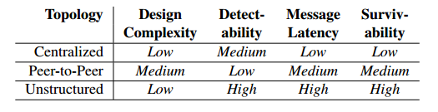
Botnet Topologies
Centralized
P2P
Unstructured

Slide 12
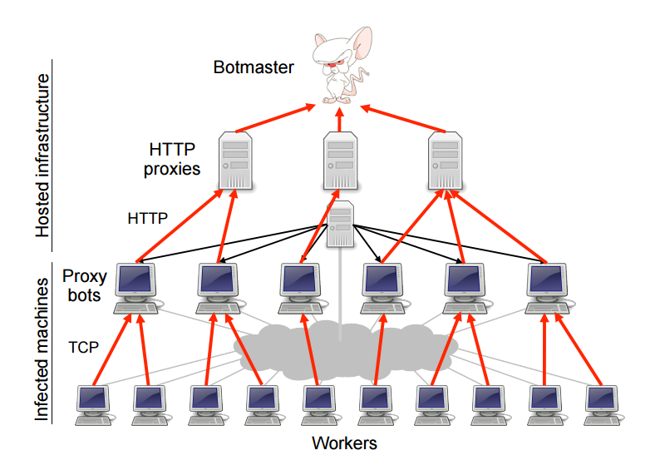
Botnet C&C channels

Slide 13
CTS 6319 Cyber Security: Measurement and Data Analysis
Dr. Elias Bou-Harb
ebouharb@fau.edu EE 503B
Office hours: Mondays 4-6pm
http://faculty.eng.fau.edu/ebouharb/

